Slide 1
بسم الله الرحمن الرحيم

Slide 2
Superstore Anaylsis
Group/ BEH_DAT_M1e
DEPI
Supervisiors:
1-Eng/yehia saied
2-Eng/mohand mohamed

Slide 3
Team Members
1- YOUSEF ELSAYED MOHAMED
2- MOHAMED ALI ALSHAER
3-MOHAMED GAMAL
4-MOSTAFA EL LAQANY

Slide 4
Agenda
Buisness question
Get data
Explore data
Prepare data
Anaylze data
Present data

Slide 5
Buisness Question
Determine:
1- total orders and total sales.
2- average sales per order.
3-sales by region and sate.
4- orders for each segment and sub –segment.
5- orders for each state.
6-sales for each category.
7- top ten product sales.
8- how to improve the sales for this store.

Slide 6
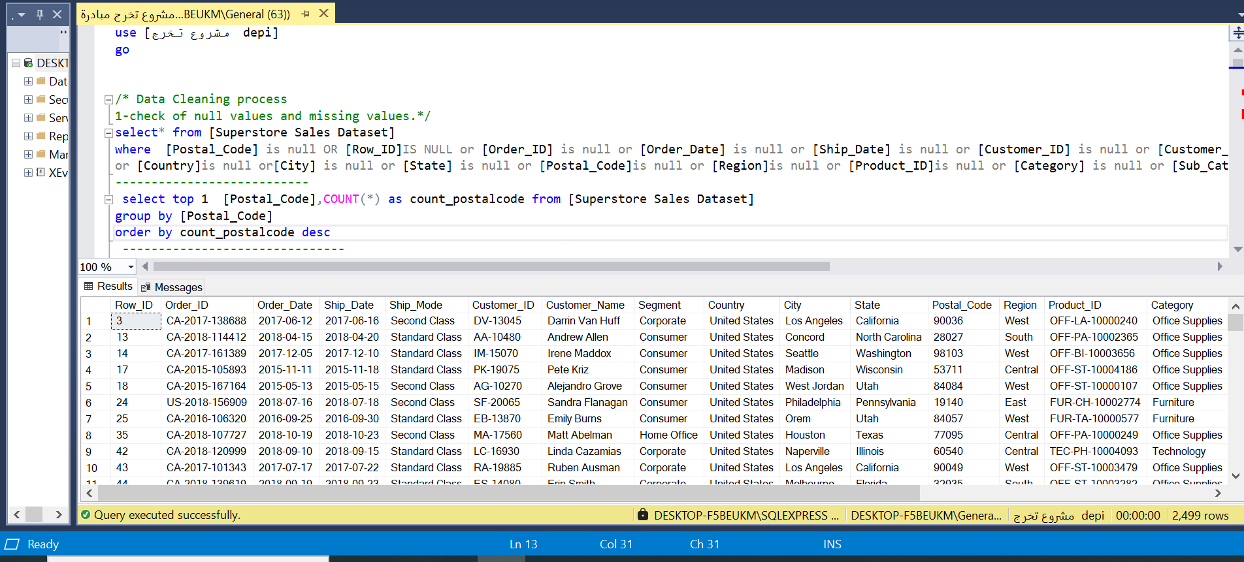
1- explore data
Using SQL server

Slide 7
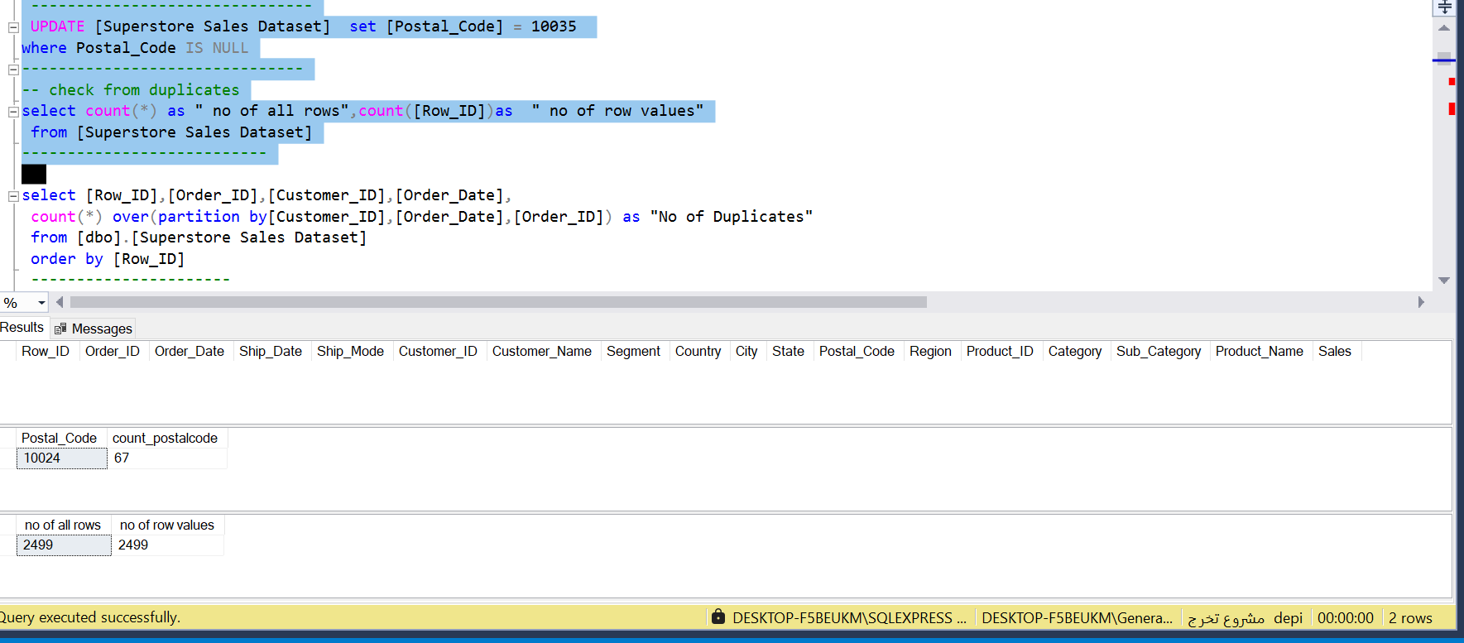
2-Clean data

Slide 8
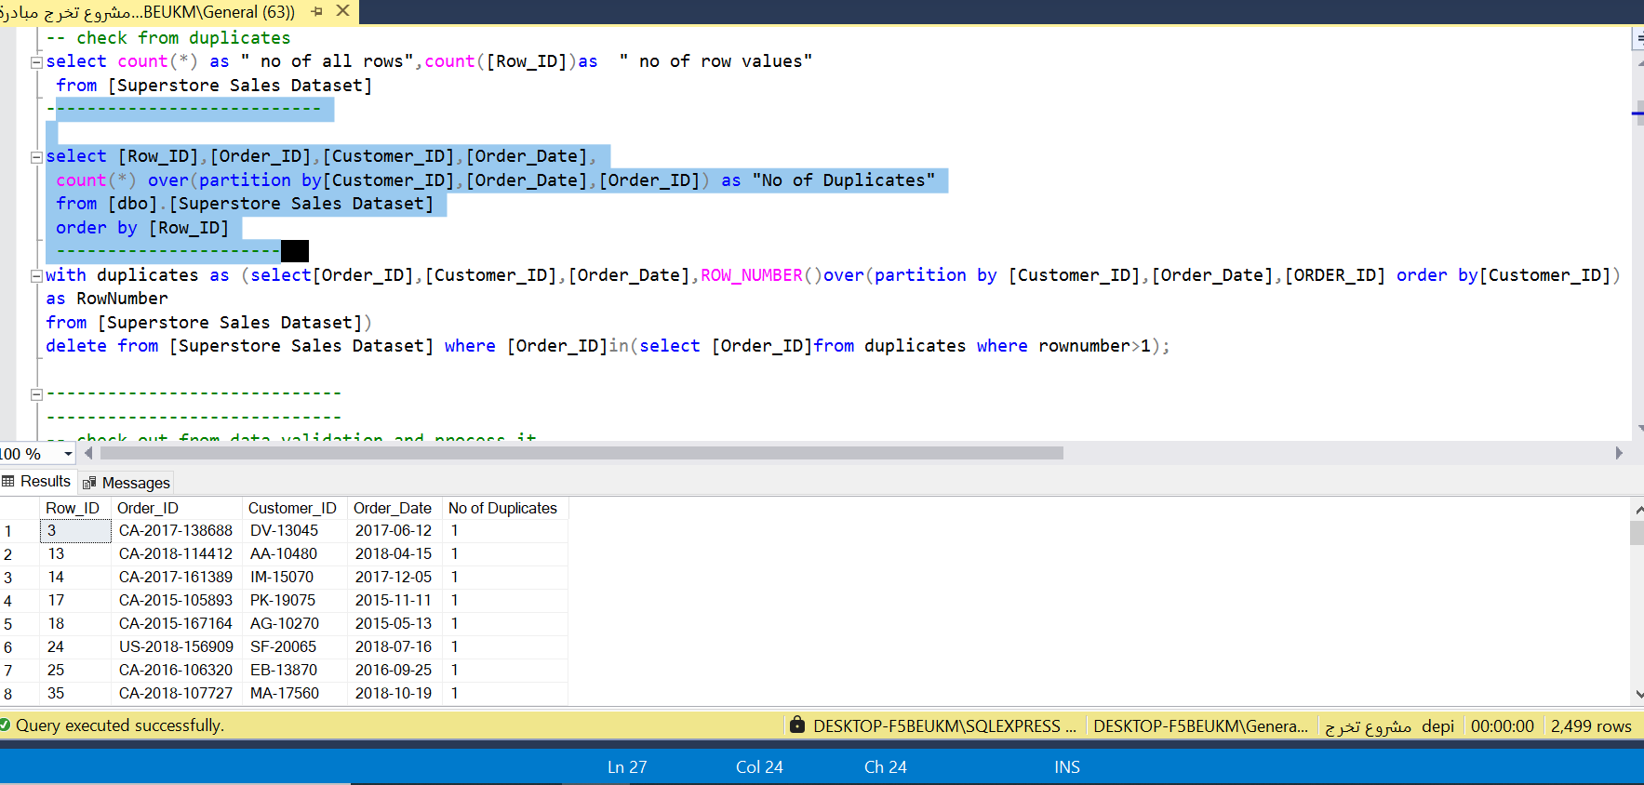

Slide 9
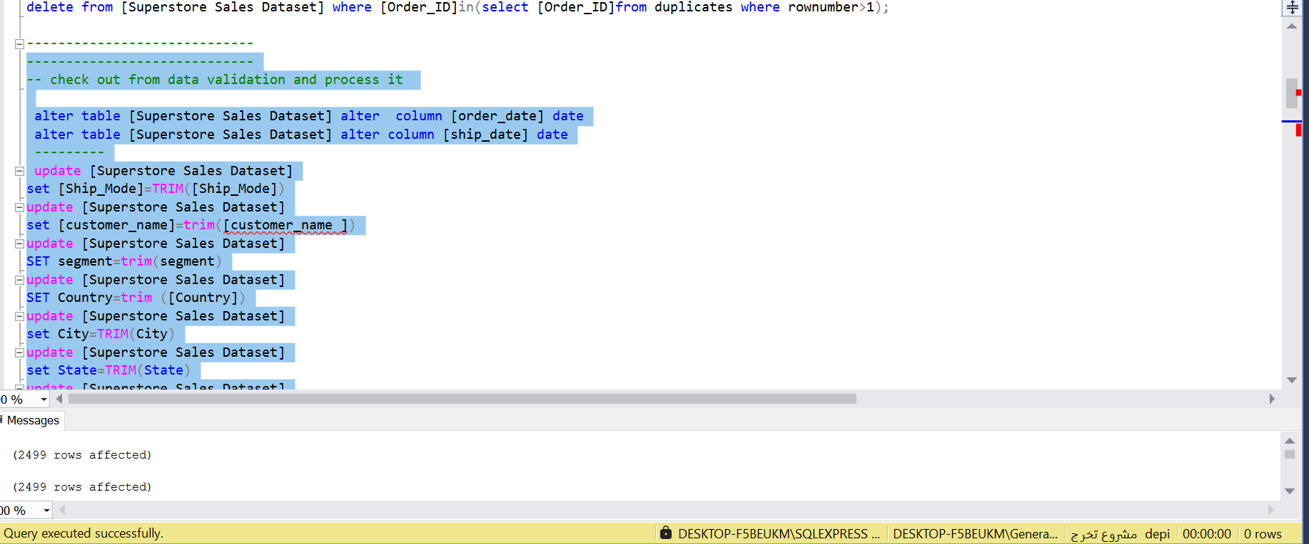
3-Check from data validation

Slide 10
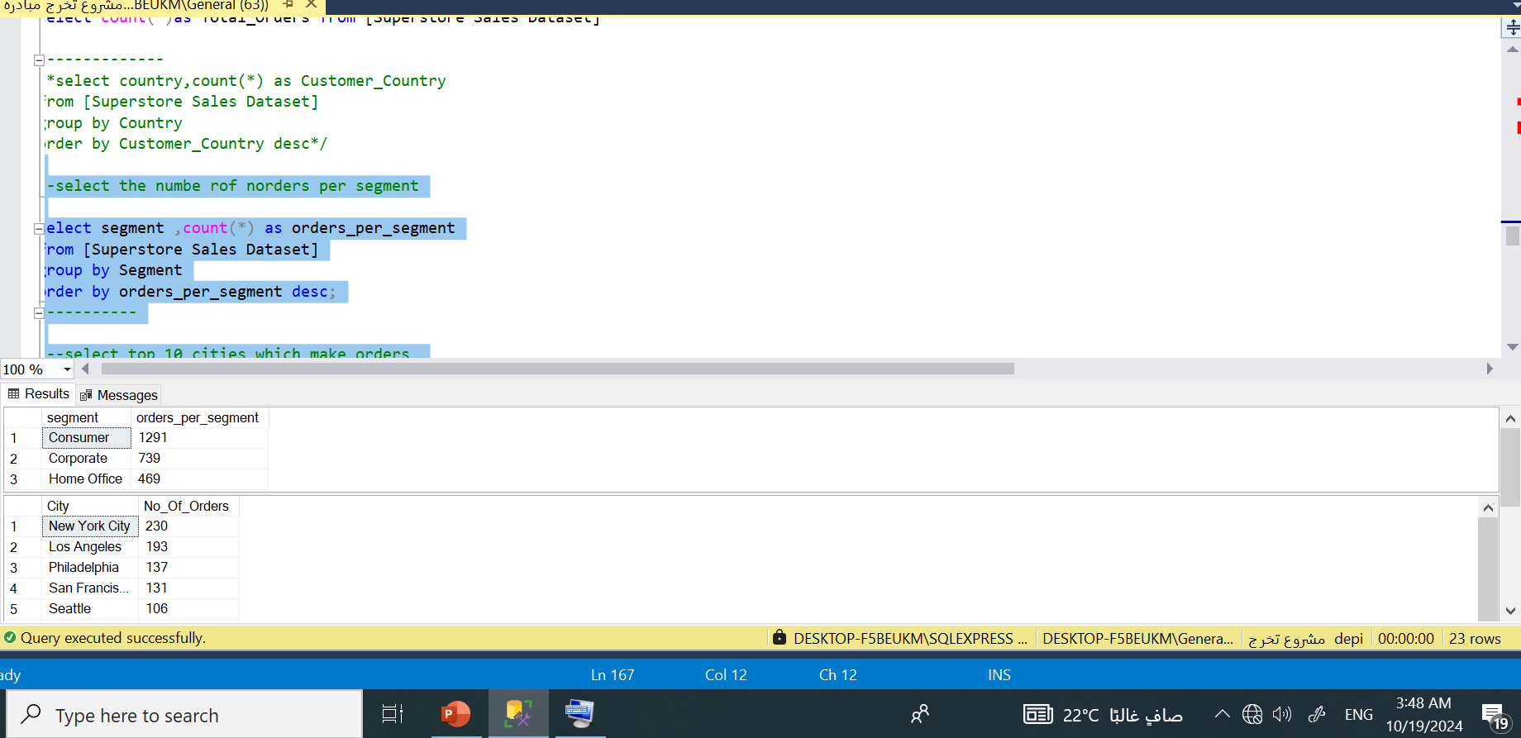
4-Analyze Data

Slide 11
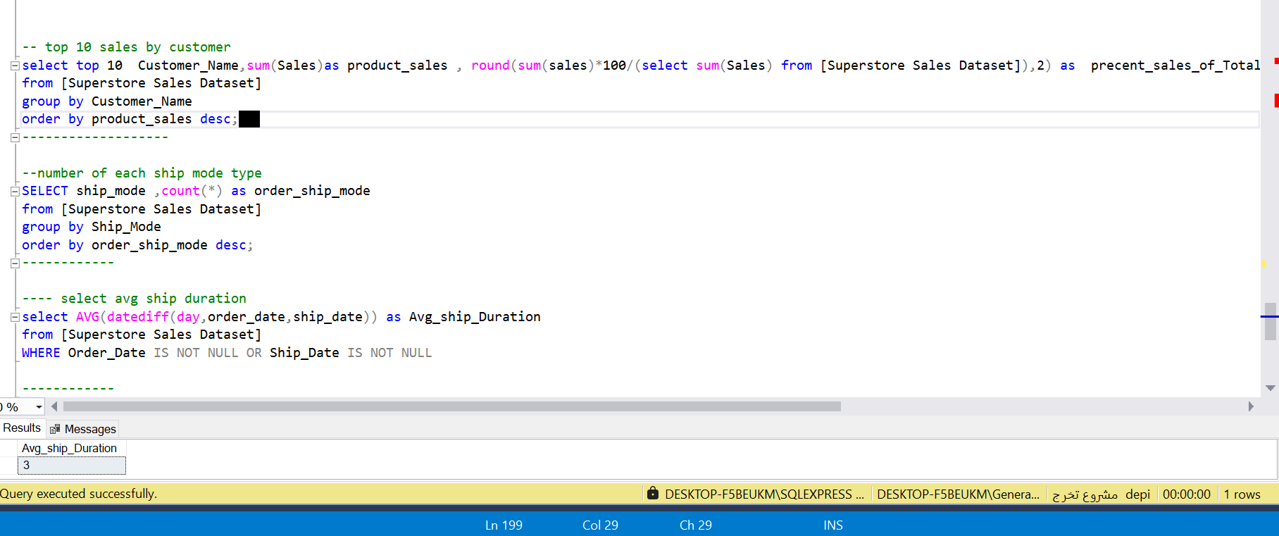
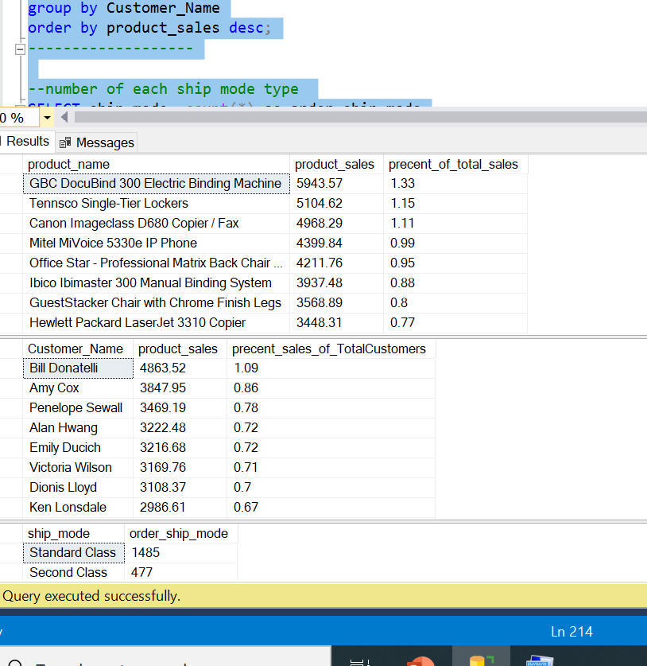

Slide 12
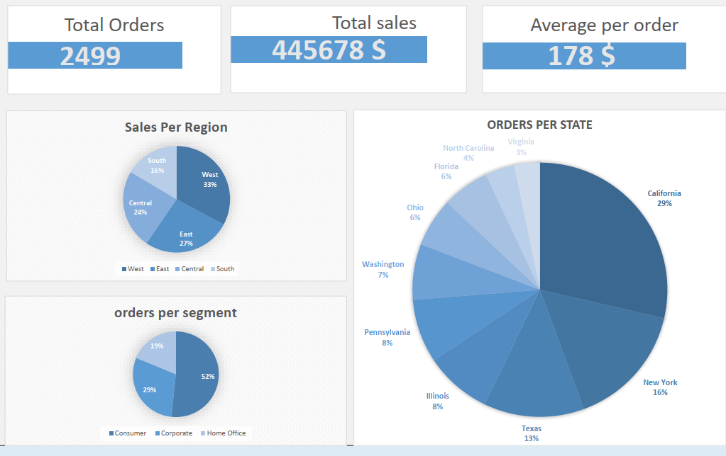
Data Visualization

Slide 13
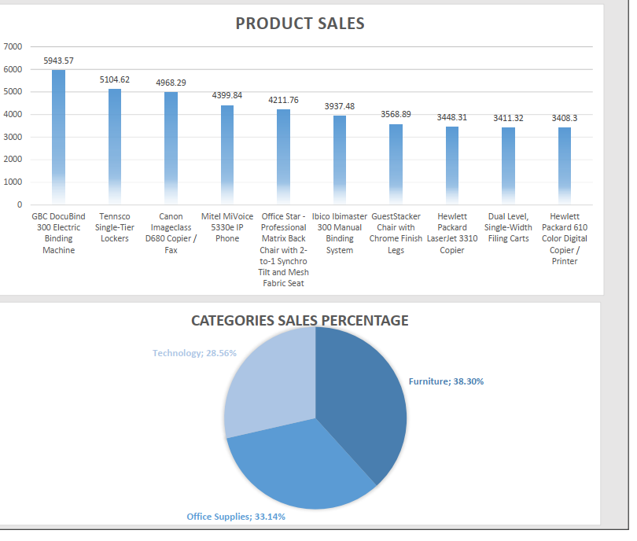
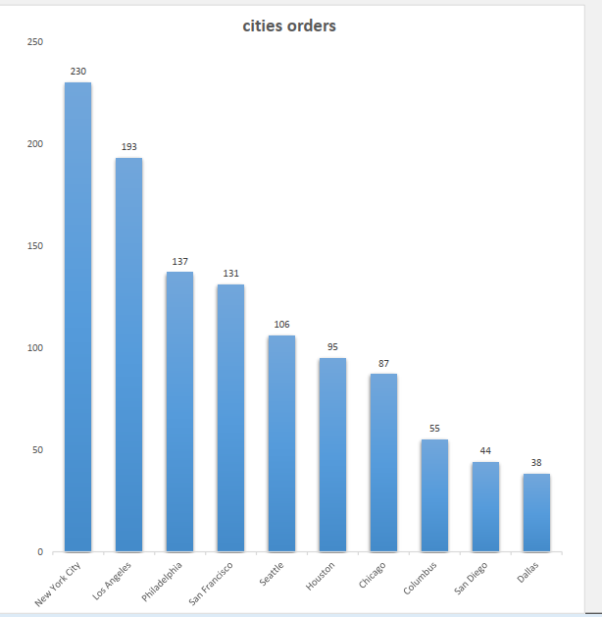

Slide 14
?
Any Questions ?
?
?

Slide 15
Thank you

